Slide 1
VLSI Test Principles and Architectures
Chapter 9, Memory Diagnosis and Built-In Self-Repair
Haochen Ding

Slide 2
INTRODUCTION
00

Slide 3
00 Introduction
The purpose of memory diagnosis is twofold:
locating failures and subsequently repairing them
analysing failures and defects and subsequently improving design and process.

Slide 4
00 Introduction
Why memory diagnosis?
There are some important issues that a pure BIST scheme does not solve, such as diagnosis and repair.
Conventional memory automatic test equipment (ATE) provides only limited information for failure analysis that usually is insufficient for fast debugging.
Why memory repair?
If BIST schemes are only for functional testing, they cannot replace external memory testers entirely, while using expensive memory testers is becoming inefficient (and therefore not cost-effective) as chip density continues to grow.
Embedded memories are even more difficult to deal with using external testers.

Slide 5
00 Introduction – Contents of This Chapter
01 Refined Fault Models and Diagnostic Test Algorithms
02 BIST with Diagnostic Support
03 RAM Defect Diagnosis and Failure Analysis
04 RAM Redundancy Analysis Algorithms
05 Built-In Self-Repair

Slide 6
Refined Fault Models and Diagnostic Test Algorithms
01

Slide 7
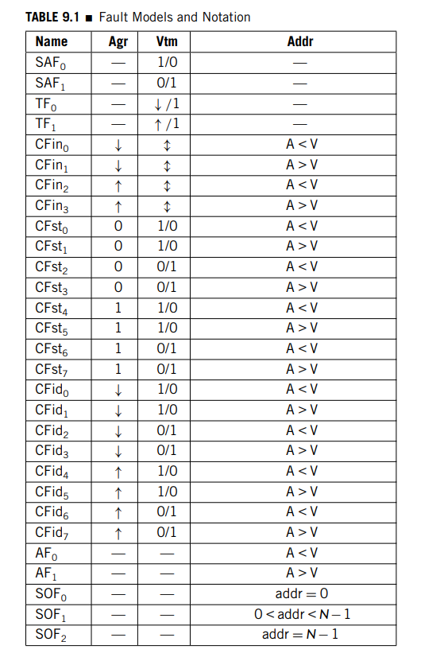
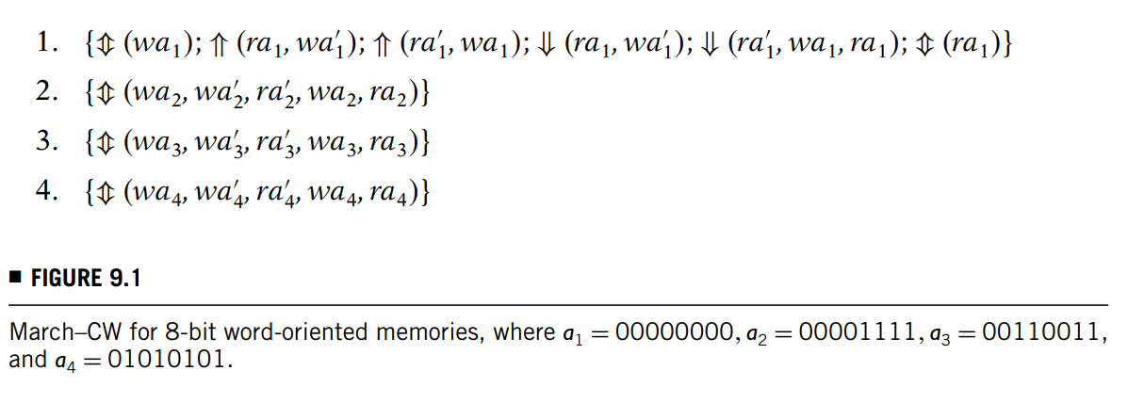
01 Refined Fault Models and Diagnostic Test Algorithms

Slide 8
BIST with Diagnostic Support
02

Slide 9
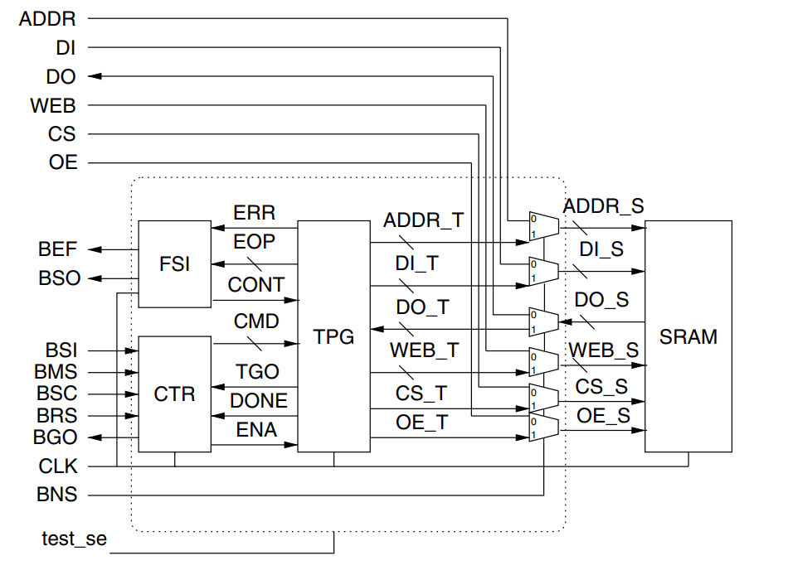
02 BIST with Diagnostic Support
The BIST core consists of three blocks:
controller (CTR)
test pattern generator (TPG)
fault site indicator (FSI).
It also has a set of multiplexers to form the test collar for the SRAM, switching between the BIST and Normal operation modes under the control of the BNS (BIST/Normal Select) signal.
The test_se signal enables scan test for the BIST circuit itself.

Slide 10
02 BIST with Diagnostic Support
Controller (CTR)
The CTR controls the overall test procedure and issues test commands for the test pattern generator (TPG) that generates test patterns for the targeted SRAM.
It has two operation modes:
In Test mode, the CTR sends a set of built-in commands to the TPG, based on the default test algorithm.
In Analysis mode, the test algorithm is user-programmable, and test commands are shifted in from the BSI.

Slide 11
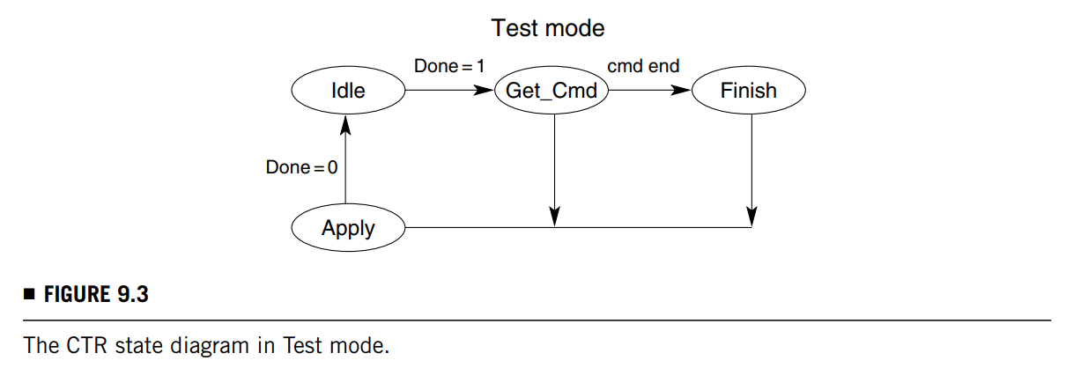
02 BIST with Diagnostic Support
Controller (CTR)
In Test mode, the CTR sends a set of built-in commands to the TPG, based on the default test algorithm.
By applying a 0 to BSC, we force CTR to the Idle state (also known as the Reset state).
From the Idle state, CTR goes to the Get_Cmd state to fetch the first command from a look-up table and send it by the CMD channel to TPG.
It then goes to the Apply state to generate the handshaking signal (ENA) to enable TPG.
When TPG is executing the test command, CTR returns to the Idle state.
When TPG completes the test command, the DONE signal is applied 1, and CTR enters the Get_Cmd state again to fetch the next command.
The process is repeated as long as there are commands to be executed.
In the Get_Cmd state, if all the commands have been executed, CTR goes to the Finish state and sends the Null command to terminate Test mode.

Slide 12
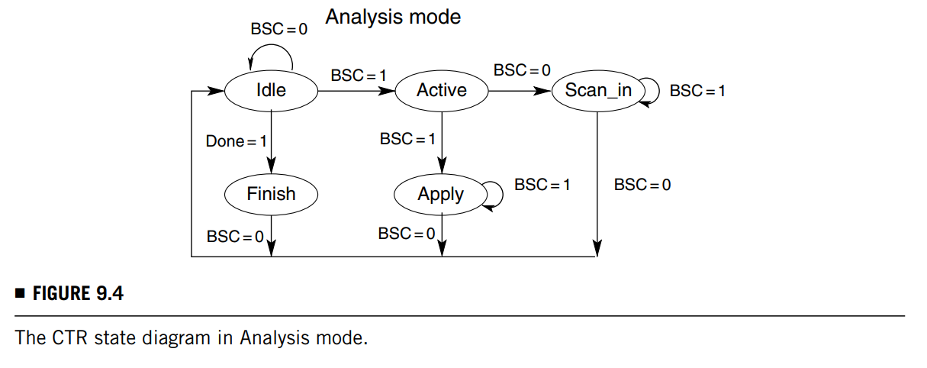
02 BIST with Diagnostic Support
Controller (CTR)
In Analysis mode, the test algorithm is user-programmable, and test commands are shifted in from the BSI.
After the Idle state, CTR goes to the Active state and then the Scan_In state if we apply 10 to BSC. In this state, CTR gets the command serially from the BSI input, then goes to the Apply state to enable TPG in a similar way as Test Mode.
CTR will go through the Idle and Active states again before entering the Apply state. This allows one to pause at the Idle state before applying test patterns.
After the command is executed, BGO output will indicate the completion of the test command.

Slide 13
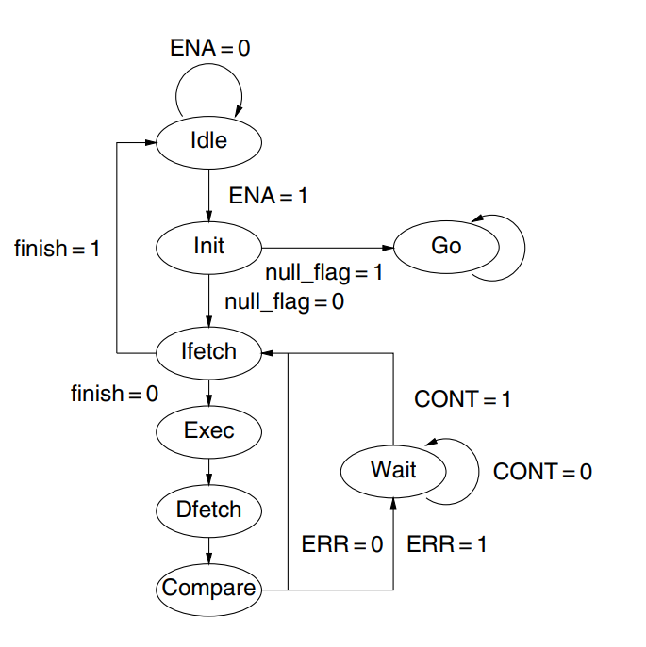
02 BIST with Diagnostic Support
Test Pattern Generator (TPG)
The test pattern generator executes the test commands issued by CTR and generates the corresponding SRAM input signals, including the data, address, and control signals.

Slide 14
02 BIST with Diagnostic Support
Test Pattern Generator (TPG)
The Idle state is the default state after resetting TPG.
When it is enabled by CTR, TPG goes to the Init state to initialize Address Counter and Session Counter.
Session Counter keeps track of the SRAM Read/Write operation (session) that is being executed on the current address.

Slide 15
02 BIST with Diagnostic Support
Test Pattern Generator (TPG)
After decoding the Opcode, we obtain the SRAM operation sequence.
If the Opcode is not a terminal command, TPG goes through the Ifetch, Exec, Dfetch, and Compare states in sequence
Otherwise, it goes to the Go state and sets the TGO value to 1 (for Go) or 0 (for No-Go) depending on whether faults have been detected.
In the Ifetch-Exec-Dfetch-Compare state sequence, TPG fetches the timing control data from the lookup table according to the current session value, then waits in the Exec state for a period of time equal to the SRAM access latency.

Slide 16
02 BIST with Diagnostic Support
Test Pattern Generator (TPG)
In the Dfetch state we get the output data from SRAM, then compare it with the fault-free data to obtain the error syndrome.
If the syndrome value is non-zero (i.e., errors are found), TPG goes to the Wait state and stores the information of the current operation in the Error Operation Protocol (EOP) registers.
If the syndrome value is zero (i.e., no errors are found), the session number is incremented by 1 and TPG repeats the Ifetch-Exec-Dfetch-Dfetch state loop until we reach the last session for the current address. When the last session is reached, the session counter is reset to 0 and we advance to the next address.
After finishing all addresses, TPG goes to the Idle state and sets the DONE signal to 1.

Slide 17
02 BIST with Diagnostic Support
Fault Site Indicator (FSI)
The fault site indicator receives error information from TPG and sends it to the BSO output serially using a scan chain.
When a fault is detected, TPG enters the Wait state, issues the Error (ERR) signal, and sets the Error Operation Protocol (EOP) data for the FSI.
FSI then sets the BIST Error Flag (BEF) signal and sends the error information to the BSO output.
After the EOP content is completely shifted out, FSI sets the CONT signal to allow TPG to continue the execution of the current test command.

Slide 18
RAM Defect Diagnosis and Failure Analysis
03

Slide 19
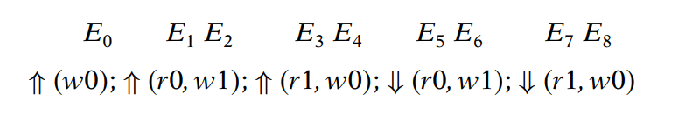
03 RAM Defect Diagnosis and Failure Analysis
After collecting the EOP data from FSI, the error bitmap of the faulty SRAM for every Read operation can be obtained.
If the SRAM has redundant resources (such as spare rows/columns), it can be repaired according to these error addresses.
Moreover, the designers and process engineers can identify the fault type and failure mode by offline analysis using the EOP data.
Arranged properly, the error data can be represented in the form of March syndromes.
E.g. IFA9N:

Slide 20
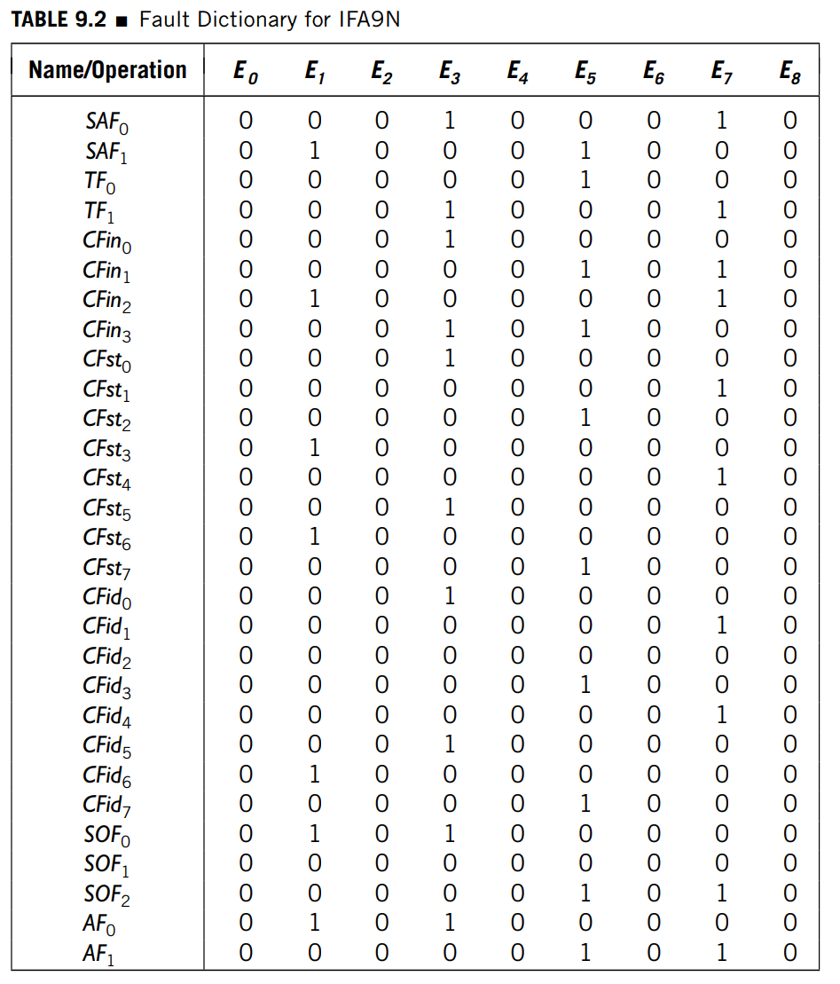
03 RAM Defect Diagnosis and Failure Analysis
The March signature for each fault model is the error domain response of the March test when the fault exists and is represented by the corresponding row in the table.

Slide 21
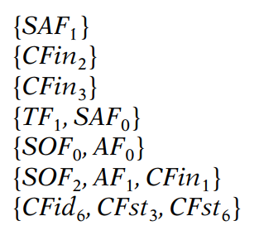
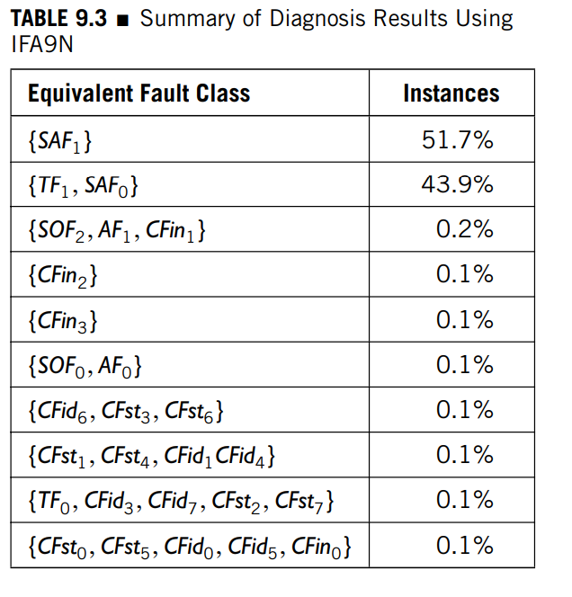
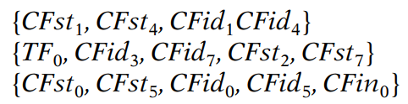
03 RAM Defect Diagnosis and Failure Analysis
Diagnosability Ratio (DR): defined as the ratio of the number of distinguishable fault types among all.
E.g. the number of total detectable fault types. For example, the DR of IFA9N is 10/27 = 37%, with the equivalent classes of fault types listed as follows:

Slide 22
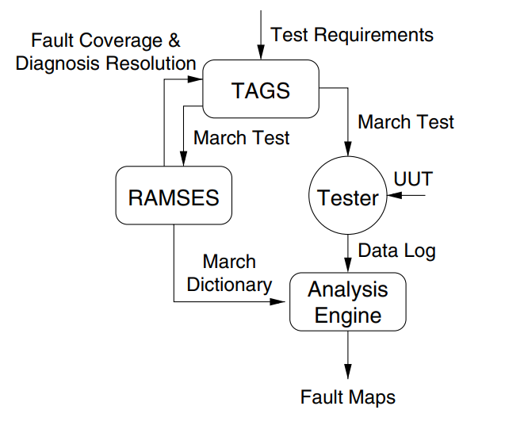
03 RAM Defect Diagnosis and Failure Analysis
Memory Error Catch and Analysis (MECA) system: it can identify fault types by comparing the syndrome of each faulty cell with all March signatures in the fault dictionary.
From the ATE data log the error bitmaps can be obtained.
RAMSES evaluates the fault coverage and diagnosability ratio and generates the fault dictionary for the March test.
TAGS generates a March test which is able to meet the test requirements.
The Analysis Engine generates error bitmaps and subsequently fault bitmaps.
In each fault bitmap, the distribution of the faulty cells is detailed by a diagram.

Slide 23
RAM Redundancy Analysis Algorithms
04

Slide 24
04 RAM Redundancy Analysis Algorithms
Conventional Redundancy Analysis Algorithms
Conventionally, redundancy analysis (RA) is performed on a memory tester using software. The tester stores the bitmap (a map of the faulty cells) after a diagnostic test and performs redundancy analysis based on the bitmap.
Most such algorithms consist of two phases
must-repair: all faulty lines that must be repaired are identified first, limiting the number of remaining faulty cells.
final-repair: simple algorithms are used, such as the fault-driven, row-first, and column-first algorithms.
It is clear that analysis time (or tester throughput) is critical as far as cost is concerned.

Slide 25
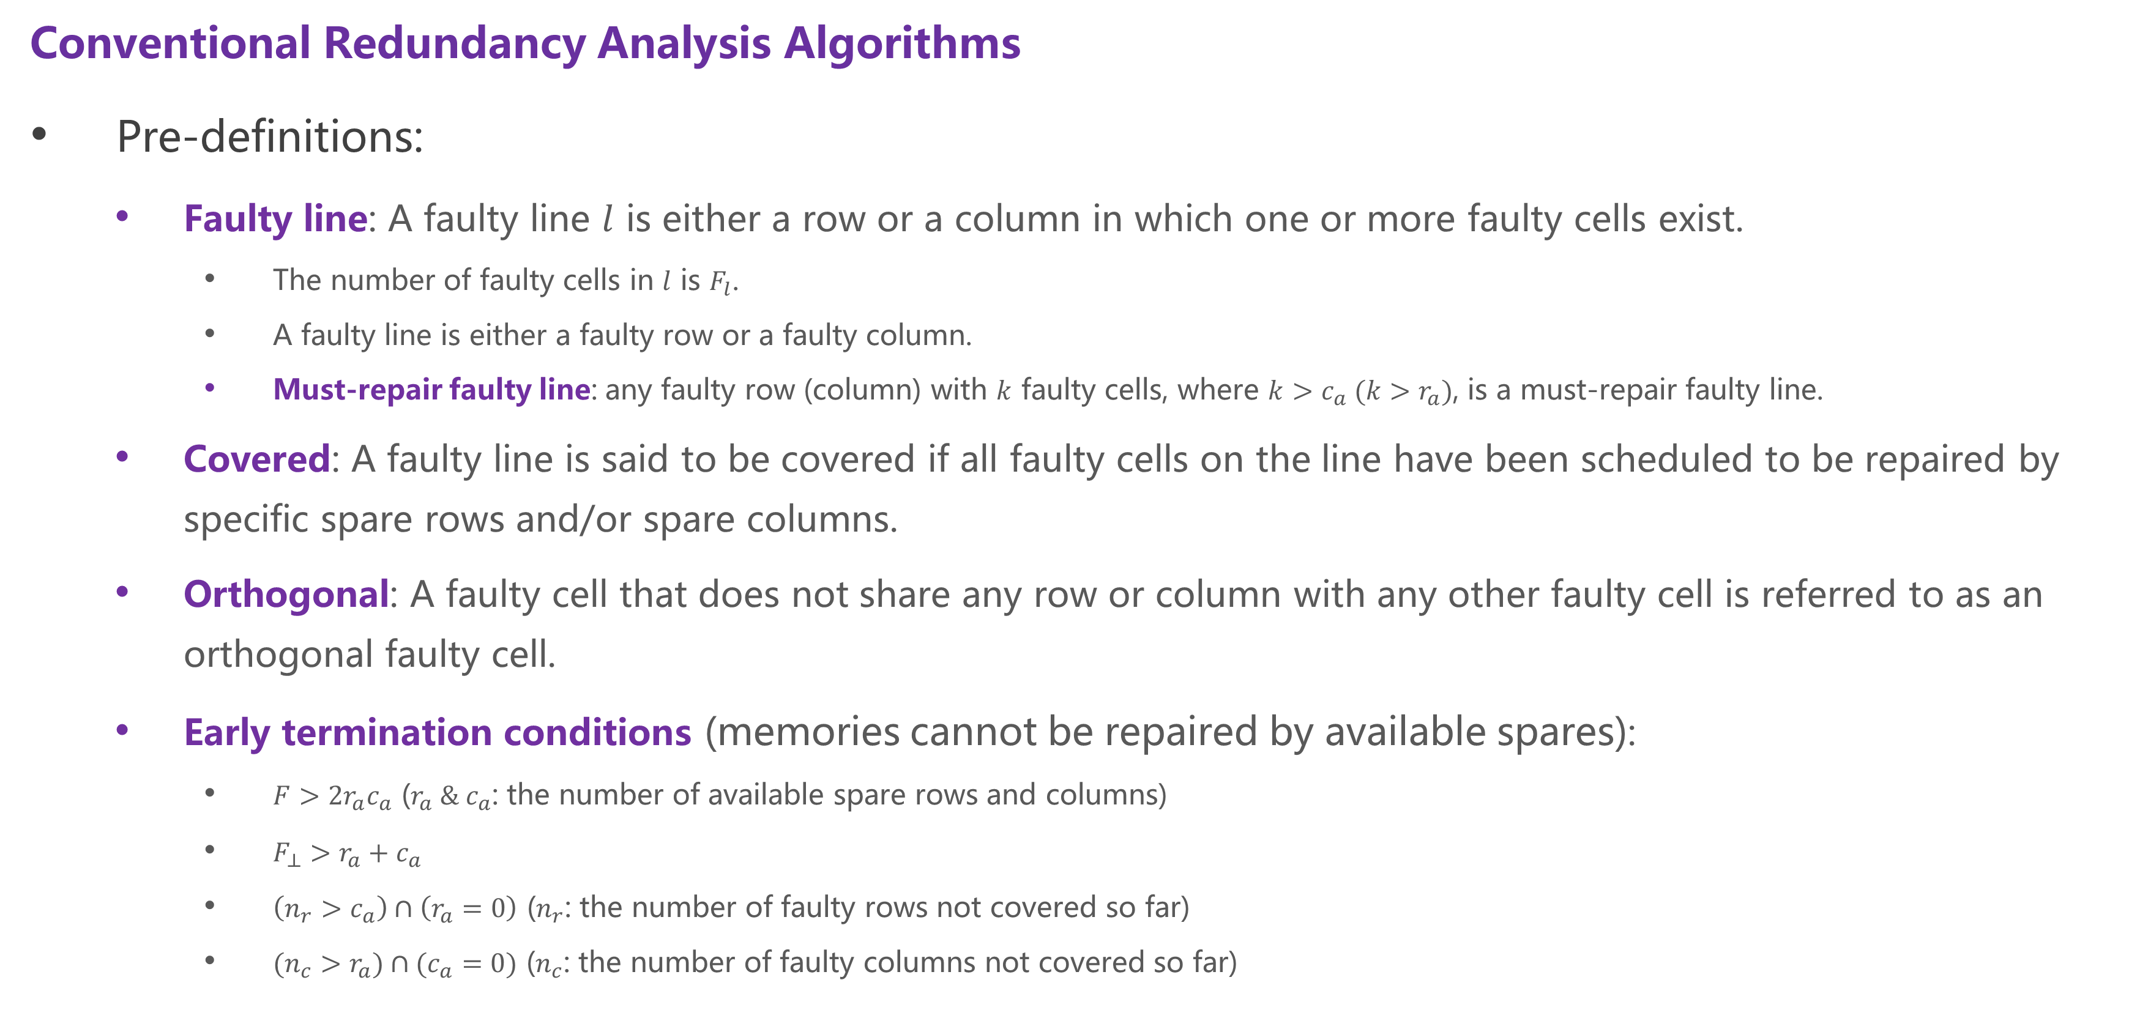
04 RAM Redundancy Analysis Algorithms
Conventional Redundancy Analysis Algorithms
Pre-definitions:
Faulty line: A faulty line $l$ is either a row or a column in which one or more faulty cells exist.
The number of faulty cells in $l$ is $F_{l}$.
A faulty line is either a faulty row or a faulty column.
Must-repair faulty line: any faulty row (column) with $k$ faulty cells, where $k>c_{a} ({k>r}_{a})$, is a must-repair faulty line.
Covered: A faulty line is said to be covered if all faulty cells on the line have been scheduled to be repaired by specific spare rows and/or spare columns.
Orthogonal: A faulty cell that does not share any row or column with any other faulty cell is referred to as an orthogonal faulty cell.
Early termination conditions (memories cannot be repaired by available spares):
$F>2r_{a}c_{a}$ ($r_{a} \& c_{a}$: the number of available spare rows and columns)
$F_{⊥}>r_{a}+c_{a}$
$\left(n_{r}>c_{a}\right)∩\left(r_{a}=0\right)$ ($n_{r}$: the number of faulty rows not covered so far)
$(n_{c}>r_{a})∩(c_{a}=0)$ ($n_{c}$: the number of faulty columns not covered so far)

Slide 26
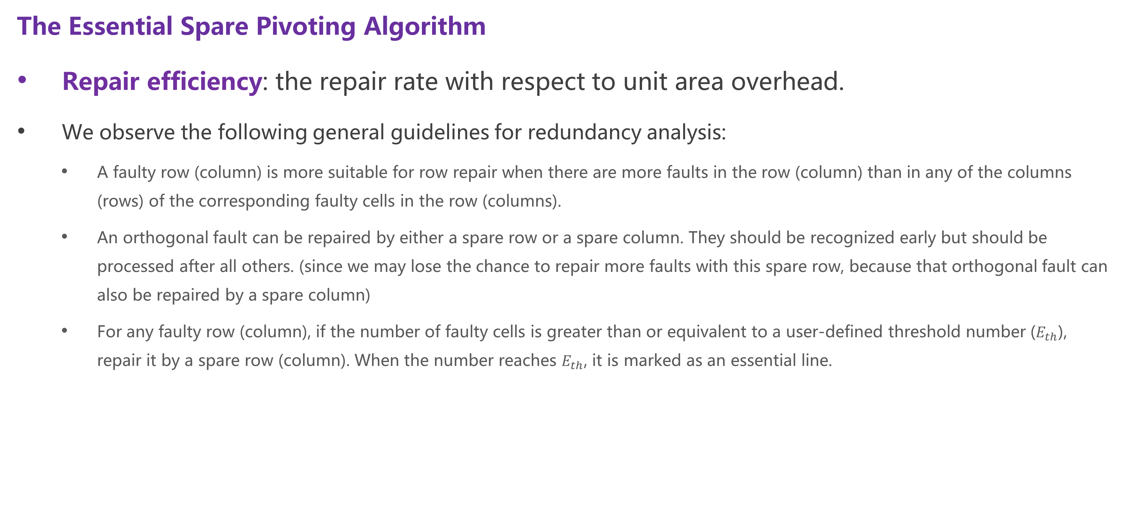
04 RAM Redundancy Analysis Algorithms
The Essential Spare Pivoting Algorithm
Repair efficiency: the repair rate with respect to unit area overhead.
We observe the following general guidelines for redundancy analysis:
A faulty row (column) is more suitable for row repair when there are more faults in the row (column) than in any of the columns (rows) of the corresponding faulty cells in the row (columns).
An orthogonal fault can be repaired by either a spare row or a spare column. They should be recognized early but should be processed after all others. (since we may lose the chance to repair more faults with this spare row, because that orthogonal fault can also be repaired by a spare column)
For any faulty row (column), if the number of faulty cells is greater than or equivalent to a user-defined threshold number ($E_{th}$), repair it by a spare row (column). When the number reaches $E_{th}$, it is marked as an essential line.

Slide 27
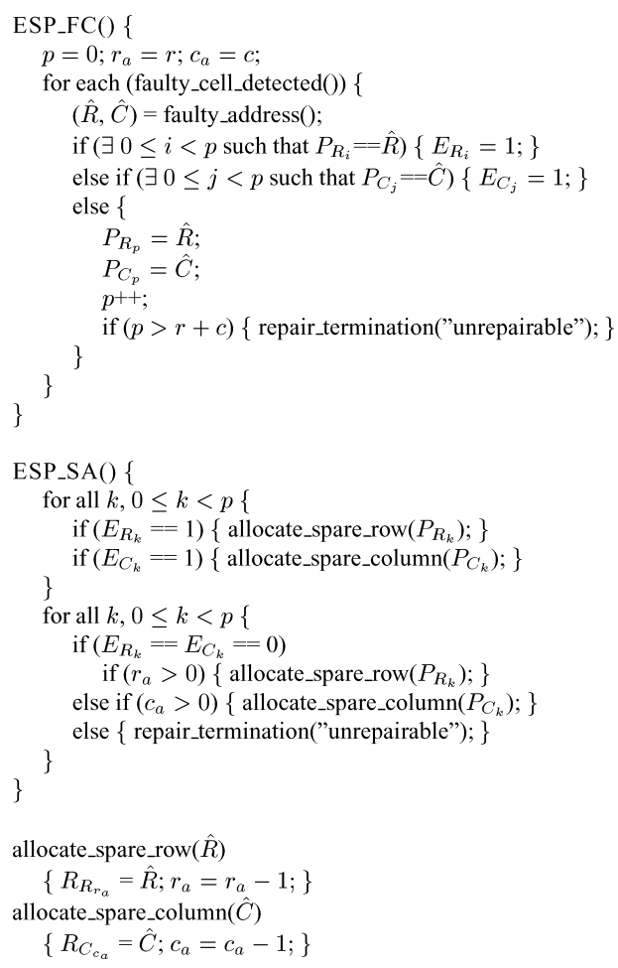
04 RAM Redundancy Analysis Algorithms
The Essential Spare Pivoting Algorithm
Greedy Algorithm ESP:
Essential
Early termination conditions
Allocate to essential lines first.
Allocate to others if there are still some left.

Slide 28
04 RAM Redundancy Analysis Algorithms
Repair Rate and Overhead
A simulator such as BRAVES (Built-in Redundancy Analysis Verification and Evaluation System) can be used for analysing the efficiency of the redundancy analysis and repair algorithms.
There are two types of faults that we can inject into the memory to be simulated
Cell fault: independent individual fault
Line fault: multiple faults exist in the same line (e.g. faulty wordline or bitline)

Slide 29
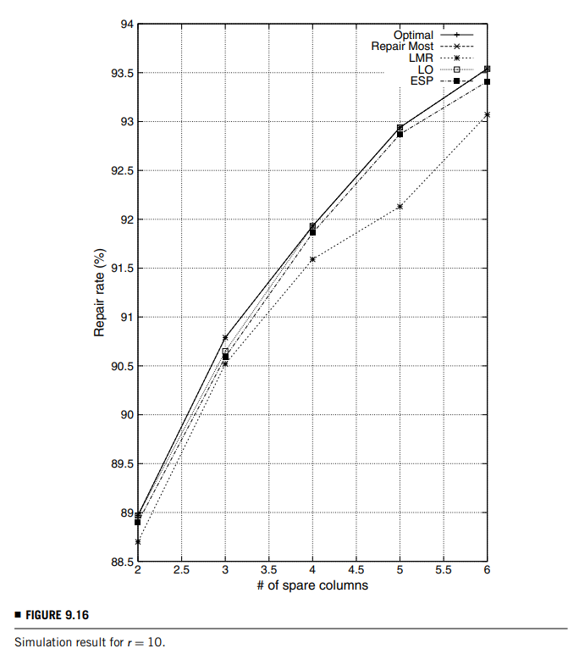
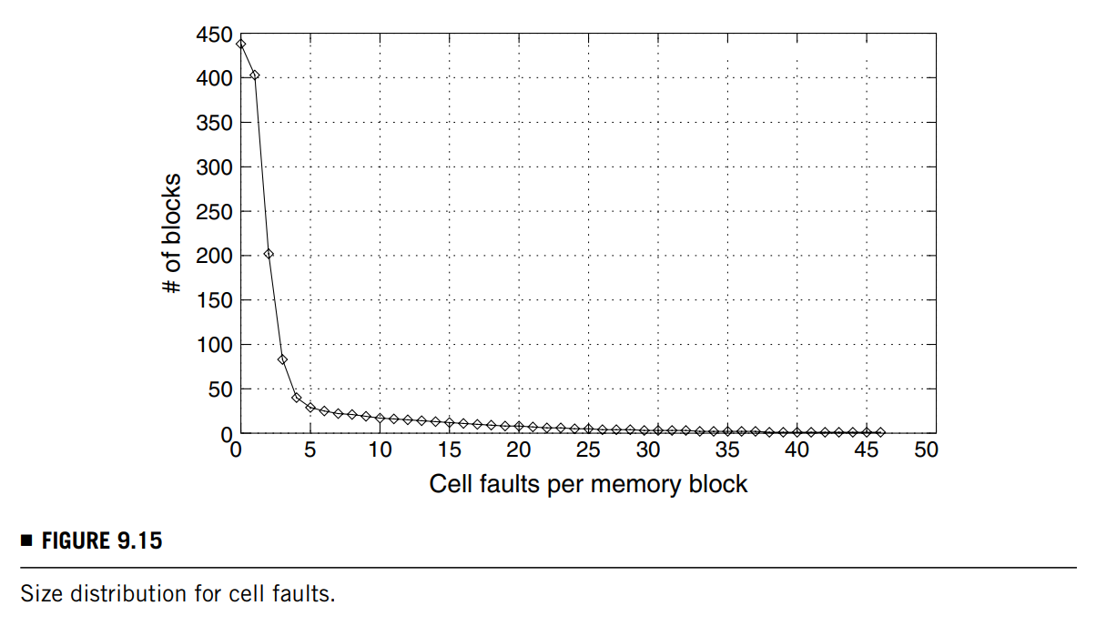

04 RAM Redundancy Analysis Algorithms
Repair Rate and Overhead
$A_{ESP}=\left(r+c\right)\left[\left(\left\lceil \log{M}\right\rceil +1\right)+\left(\left\lceil \log{N}\right\rceil +1\right)\right]$
$A_{spare_register}=\left(\left\lceil \log{M}\right\rceil +1\right)·r+\left(\left\lceil \log{N}\right\rceil +1\right)·c$

Slide 30
Built-In Self-Repair
05

Slide 31
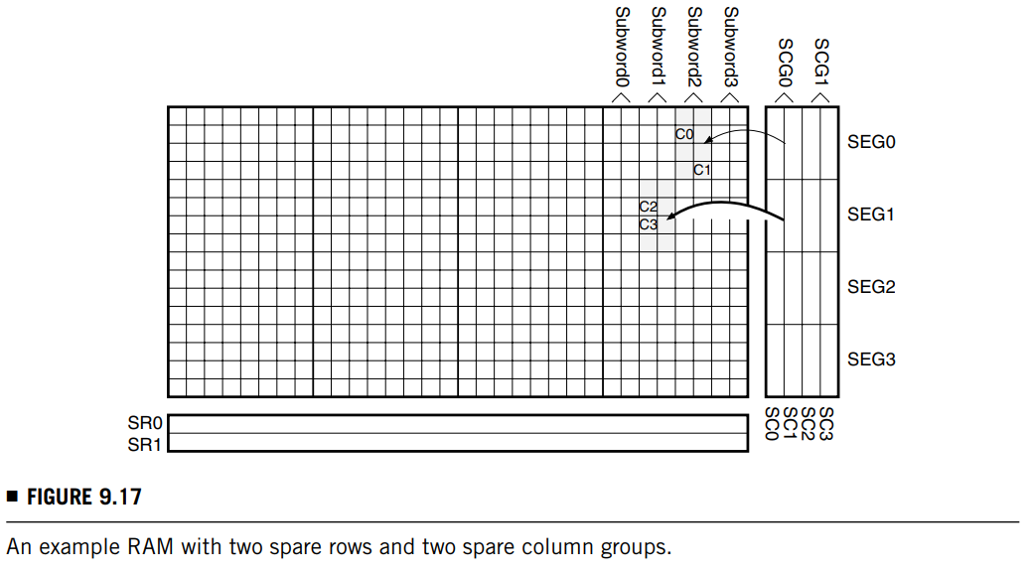
05 Built-In Self-Repair
Redundancy Organization
In the figure, a 512-bit RAM has 2 spare rows at the bottom and 4 spare columns on the right.
If there is a faulty row, any of the spare rows (SR0 and SR1) can be used to replace it
However, spare columns are used differently:
We partition them into several spare column groups (SCGs). In the figure, two spare columns are grouped into an SCG; the group size is 2—group SCG0 (resp. SCG1) contains columns SC0 and SC1 (resp. SC2 and SC3).
Also, a word is divided into multiple subwords, where a subword contains consecutive bits of the word, whose length is the same as the group size.
The segments are identified by the first two most significant bits (MSBs) of the row address.

Slide 32
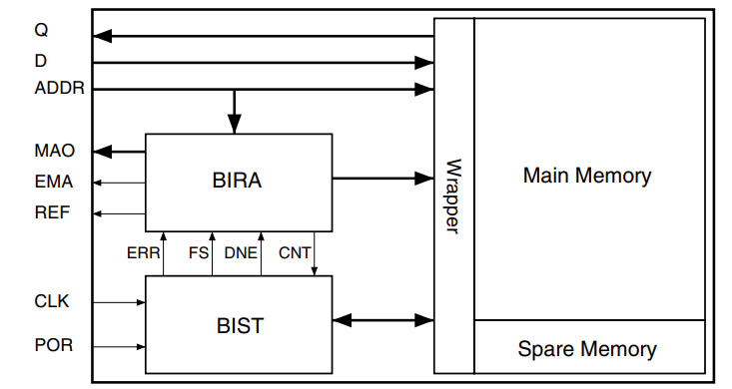
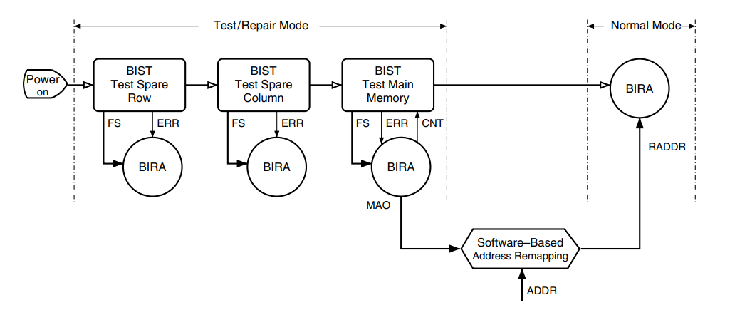
05 Built-In Self-Repair
BISR Architecture and Procedure
The BIRA circuit performs redundancy allocation using a novel RA algorithm.
The test wrapper switches the memory between test/repair mode and normal mode.
In test/repair mode the memory is accessed by the BIST module
In normal mode the wrapper selects the data outputs either from the main memory or the spare memory (replacing the faulty memory cells) depending on the control signals from the BIRA module.

Slide 33
05 Built-In Self-Repair
BISR Architecture and Procedure
During the RA procedure, if a spare row is requested but there are no more spare rows, the BIRA module exports the faulty row address through the Export Mask Address (EMA) and Mask Address Output (MAO) signals. The memory will then be operated at a downgraded mode (i.e., with a smaller usable capacity) by software-based address remapping

Slide 34
05 Built-In Self-Repair
BISR Architecture and Procedure
Downgraded Mode: during the RA procedure, if a spare row is requested but there are no more spare rows, the BIRA module exports the faulty row address through the Export Mask Address (EMA) and Mask Address Output (MAO) signals. The memory will then be operated at a downgraded mode (i.e., with a smaller usable capacity) by software-based address remapping. The size of the memory is thus reduced, as one block is removed.

Slide 35
05 Built-In Self-Repair
BISR Architecture and Procedure
REF: When the main memory test and RA are finished, the Repair End Flag (REF) signal goes high and the BIRA module switches to the normal mode.

Slide 36
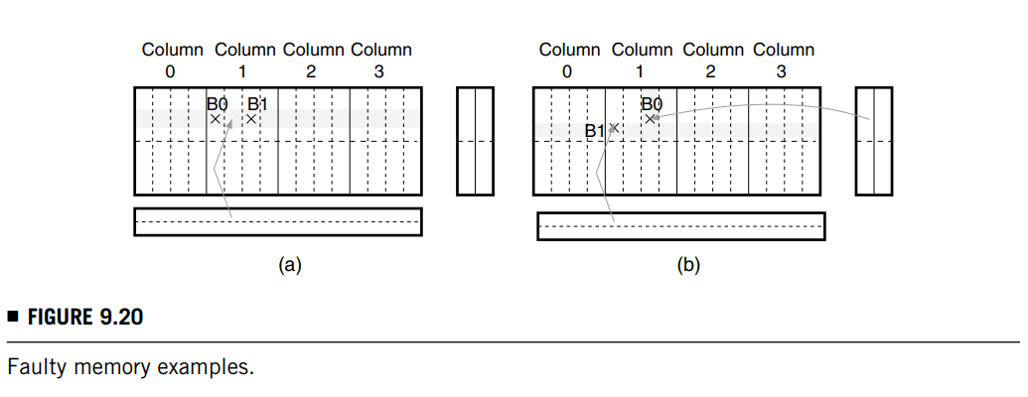
05 Built-In Self-Repair
BISR Architecture and Procedure
Row Repair Rules:
Rule 1: if a row has multiple faulty subwords, we repair the faulty row by a spare row if available.
Rule 2: if there are multiple faulty subwords with the same column address and different row addresses within a segment, the last detected faulty subword should be repaired with an available spare row.

Slide 37
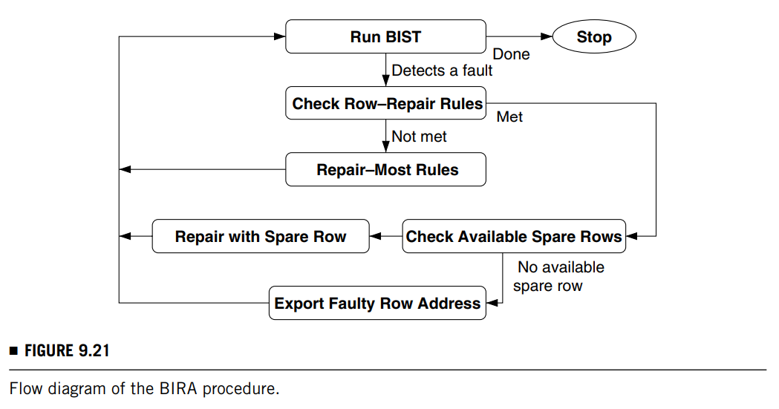
05 Built-In Self-Repair
BISR Architecture and Procedure

Slide 38
05 Built-In Self-Repair
BIRA Module
The BIRA module has three components:
multiple faulty subwords detector (MFSD): it detects whether the number of faulty subwords on a row is larger than one.
process element (PE): to be discussed later.
address remapping unit (ARU):
In the test/repair mode, ARU stores the addresses of the faulty cells detected so far and compares the current faulty-cell address with the stored ones.

Slide 39
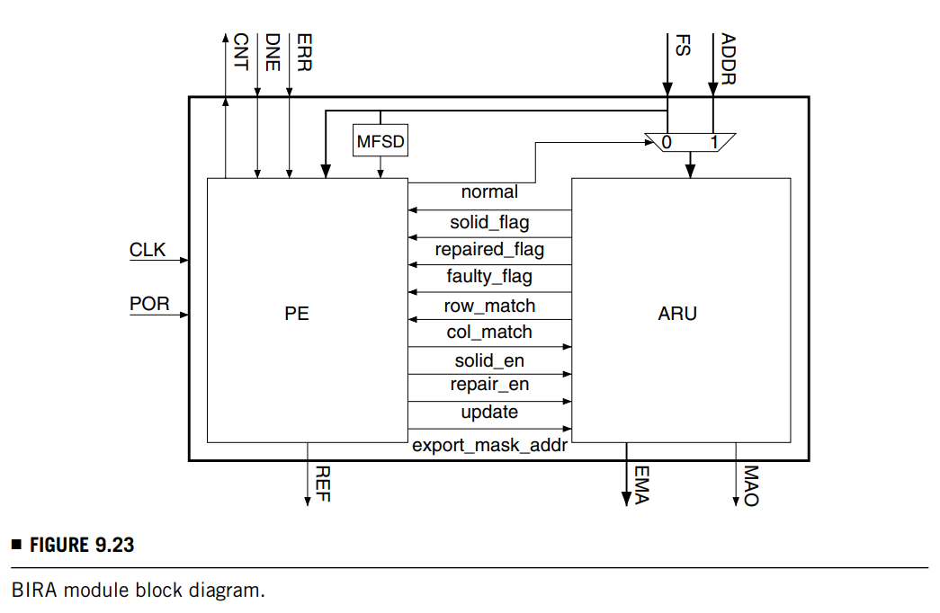
05 Built-In Self-Repair
BIRA Module
When power is on, all flip-flops are reset to the initial state. Signal normal is 0 and FS is connected to ARU. The Input Address (ADDR) is sent to ARU when it is in normal mode normal = 1.
Initially, signals solid_flag, faulty_flag, repaired_flag, row_match, and col_match are all reset to 0.

Slide 40
05 Built-In Self-Repair
BIRA Module
The PE evaluates the status of these signals and issues control signals solid_en, repair_en, update, and export_mask_addr to ARU, which then updates the status of its registers.
Signals REF (repair end flag), EMA (export mask address), and MAO (mask address output) are connected to ATE.

Slide 41
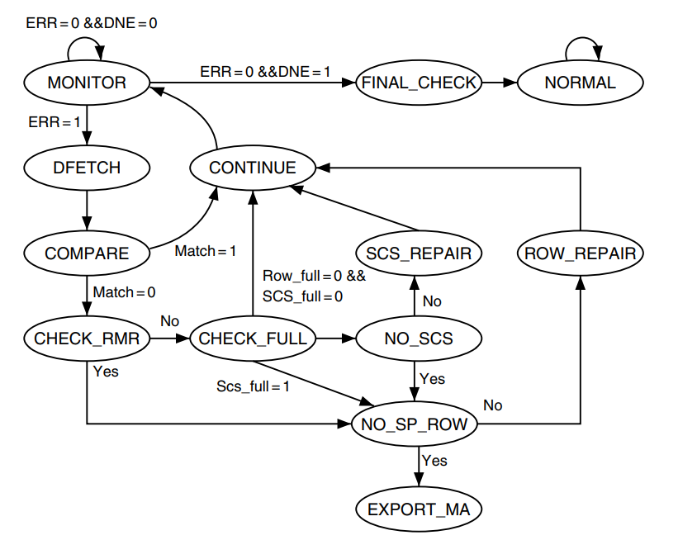
05 Built-In Self-Repair
BIRA Module
Process Element (PE): it is implemented by a finite-state machine.
In the FINAL_CHECK state, the FSM checks and sets the repair flags (explained below) of the remaining faulty addresses which are not repaired.
Finally, in the MONITOR state, if the BIST module issues a done signal to PE, the FSM will go to the NORMAL state through the FINAL_CHECK state.
The initial state is MONITOR, which monitors the ERR signal from the BIST circuit.
In the COMPARE state, PE compares the faulty address with the previously stored addresses.
If there is a match, PE goes back to the MONITOR state through the CONTINUE state. Otherwise, it goes to the CHECK_RMR state.
If the status is must-repair (by row), then it goes to the NO_SP_ROW state and checks whether there are available spare rows.
If a fault is detected, PE goes to the DFETCH state to load the status data into the flip-flops.
If no spare row is available, it sends a signal to ARU that will then export the faulty row address for software-based repair later in the downgraded operation mode.
If, on the other hand, a spare row is available, then the faulty row is replaced by the spare row in the ROW_REPAIR state, and PE goes back to the MONITOR state through the CONTINUE state, where a continue signal is issued to the BIST circuit.
If, in the CHECK_RMR state, the must-repair conditions are not satisfied, PE will go to the CHECK_FULL state to see if the solid flags (explained below) in ARU are on—if all spare rows (resp. column segments) are full, spare column segments (resp. rows) are used for repair (unless both are full). It then goes to either the NO_SP_SCS state or NO_SP_ROW state.

Slide 42
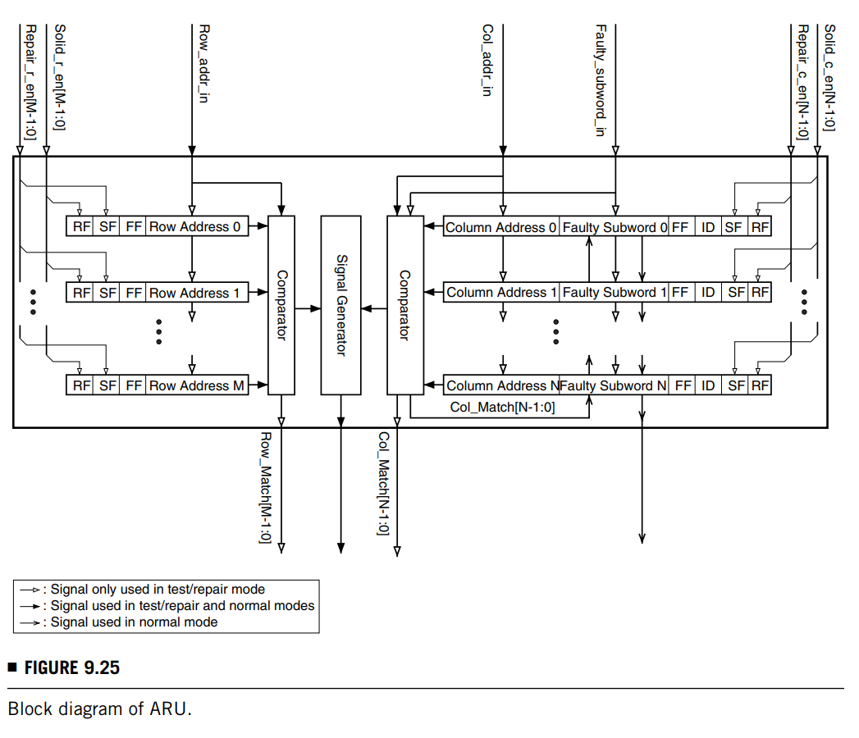
05 Built-In Self-Repair
BIRA Module
Address Remapping Unit (ARU): an ARU block diagram mainly contains the storage elements (registers), comparators, and a signal generator.
Then M row storage elements and N column storage elements are implemented. Each storage element has three status flags
Fault Flag (FF): it denotes whether the corresponding spare element is defective FF = 1 or fault-free FF = 0.
Repair Flag (RF): it indicates whether the spare element is used to repair the defective main memory RF = 1 or not RF = 0.
Solid Flag (SF): it shows whether the storage element has loaded the faulty cell information SF = 1 or not SF = 0.
Each column storage element has an identification (ID) field to store its segment number.

Slide 43
05 Built-In Self-Repair
BIRA Module
If a fault is detected, the FF of its corresponding storage element is set to 1.
The main memory is tested next.
The row address, column address, and faulty subwords are compared with the data stored in the storage elements with SF = 1 and FF = 0. The results are exported from the Row_match and Col_match terminals to PE.
If there is no match, fault information is written into an empty storage element, and PE sets its SF SF = 1 through the Solid_r_en or Solid_c_en input.

Slide 44
05 Built-In Self-Repair
BIRA Module
The Row_addr_in and Col_addr_in inputs are the address inputs in normal mode.
When the memory is accessed, the address also is compared with those stored in the storage elements.
If it is the same as one of the stored addresses, the signal generator triggers the control signals to reconfigure the I/Os between the main memory and spare memory.

Slide 45
Thanks for listening!
Haochen Ding

